Slide 1
Travelers Statistical Modeling Competition U of M
Monday November 2nd, 2020

Slide 2

Travelers Company Overview
The Travelers Companies, Inc. is a leading provider of property casualty insurance for auto, home and business
Operates in United States, Canada, U.K., Ireland, Brazil and Colombia
Approximately 30,000 employees
Generated net income of $2.5 billion and revenues of $28 billion in 2018
The ONLY insurance company on the Dow Jones Industrial Average
Notes:
Before we talk Travelers, let’s start by defining what exactly insurance is. Insurance is defined as protecting loss by sharing risk with others. Its origin dates back over 5,000 years to China and today the insurance industry employs over 2.3 million in the U.S. alone.

Slide 3



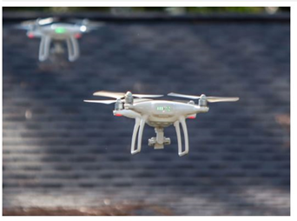



What We Do
Personal
Insurance
Commercial
Insurance
Claim
Service
Offerings
Boiler & Machinery
Commercial Auto & Trucking
Cyber
Environmental Liability
Excess Casualty & Umbrella
General Liability
Global Insurance
Inland Marine
National Programs
Ocean Marine
Property
Small Business Owner’s Policy
Surety Bonds
Workers Compensation
Property
Auto
Boat & Yacht
Wedding

Slide 4
Dynamics within Insurance Industry
Customers are extremely price sensitive.
High number of competitors in the market place.
Insurance is highly regulated by state governments.
Price cannot be excessive.
Price cannot be inadequate.
Price cannot be discriminatory.
Cost is not known in advance.
Even when a claim comes in, can develop over a long time.
Costs are impacted by a wide variety of drivers.
Medical costs
Construction costs
Litigation

Slide 5
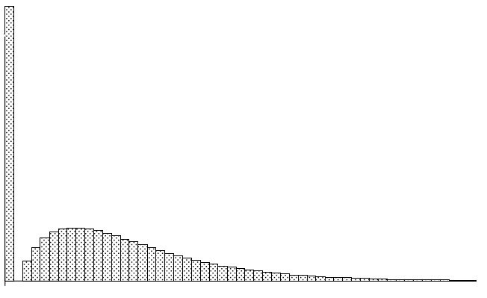
Model Building in Travelers: pricing example
Generalized Linear Models (GLMs)
Potential response variables:
Claims – Frequency (# claims / exposure) (e.g. Poisson, Negative Binomial)
Loss – Severity (loss $ / claim) (e.g. Gamma, Inverse Gaussian)
Pure Premium = Frequency * Severity = loss $ / exposure
A common link function is g(x) = ln(x).
Probability distribution: Tweedie
Compound distribution of a Poisson claim #
And a Gamma claim size distribution
Large spike at 0 for policies with no claims
Wide range of amount in the claims
Challenges include:
Variable selection
Bias-variance trade-off
* Source: “A Practitioner's Guide to Generalized Linear Models”
5
Notes:
The bias-variance tradeoff is a central problem in supervised learning.
Ideally, one wants to choose a model that both accurately captures the regularities in its training data, but also generalizes well to unseen data.

Slide 6

Travelers Statistical Modeling Competition

Slide 7
Travelers Modeling Competition
Problem: InsNova Auto Insurance Company Modeling Problem
Competition Time: November 2nd – December 2nd
Presentations: December 3rd and December 4th
2 Winning Teams
Prizes:
- Day of Job Shadowing Travelers Modeler
- Lunch with Travelers Analytics Executives
- Resume Builder
- Bragging rights.

Slide 8
2019 Travelers Case Competition Summary
Business Problem:
You work for InsNova Auto Insurance Company, an Australian company. Your business partner, who is not familiar with statistics at all, would like you to create a rating plan based on the historical auto claim data. Your business partner is concerned about segmentation as well as competitiveness, as there are several other competitors in the market.
For this case competition, your group’s task is to provide a method for predicting the claim cost for each policy and to convince your business partner that your predictions will work well.

Slide 9
Competition Rules
Competition Rules:
Participants will be randomly assigned into teams and work on the project as a team.
Evaluation metric on Kaggle: the Gini index.
Evaluation component: the Gini index and presentation
Work together within your group, but not between groups.
Models can be built using any software, python/R/SAS are preferred.
Benchmark Model
The benchmark will be a traditional actuarial pricing model using GBM.

Slide 10
Competition Rules
Presentation Instructions
Recall that the audience of the presentation is your non-statistician business partner
a. What methods did you consider (you don’t have to have actually tried all of these methods)?
b. What method did you choose in the end and why?
c. How did you do the variable selection?
d. What variables help explain pure premium?
e. What other variables not in the data set do you think might be useful?
Some bonus items to think about and address if possible:
f. How did you test the assumptions of this method?
g. How did you evaluate your model (e.g. fit statistics, over-fitting, etc.)?
h. Any concerns about the resulting model?
i. What questions to you have about the data?
Winners will be chosen based on both Kaggle scores as well as presentations

Slide 11
Data Information
The InsNova data set is based on one-year vehicle insurance policies from 2004 to 2005.
There are 45,239 policies, of which around 6.8% had at least one claim.
The data is split to two parts: training data, testing data.
In the test set, claim_cost, claim_ind and claim_counts are omitted.
You can build your model on the training data and test the model on testing data. In the end, use your best model to score the testing data.
We will evaluate your model based on your testing data prediction.

Slide 12
Variable Descriptions
InsNova_train.csv
ID: policy key
Veh_value: market value of the vehicle in $10,000’s
Veh_body: Type of vehicles
Veh_age: Age of vehicles (1=youngest, 4=oldest)
Gender: Gender of driver
Area: Driving area of residence
Dr_age: Driver’s age category from young (1) to old (6)
Exposure: The covered period, in years, a numerical variable (always between 0 and 1). The amount of time a vehicle was “exposed” to potential accidents.
Claim_ind: Indicator of claim (0=no, 1=yes)
Claim_counts: The number of claims
Claim_cost: Claim amount

Slide 13
Sample Data
InsNova_train Data
InsNova_test Data

Slide 14
Kaggle In-Class
All competition information will be on Kaggle In-Class competition website.
You are only permitted to use the data provided – third party data sources are NOT to be used.
Please make sure to post all your question on “Discussion” board. Our competition committee will answer the questions as soon as possible.
You can also share your code for EDA or modeling on “Kernels”.
You can submit 3 times per day and check your model performance on “Public Leaderboard”.
You can submit 2 times in all for private data. The final rank is based on “Private Leaderboard”.

Slide 15
Timeline & Next Steps
November 2nd @ 10:00 PM – Start date of competition
A Kaggle link will be sent to your UMN email box with the team assignment
December 2nd @ 10:00 PM – Close date of competition
Group Presentations:
December 3th
December 4th

Slide 16



Leadership and Development Programs
Leadership Programs*
Actuarial
Advanced Analytics
Financial Management
Human Resources
Information Technology
Insurance Operations
Development Programs
Bond & Specialty Insurance Underwriting
Business Insurance Underwriting
Business Intelligence and Geospatial*
Claim Professional Trainee
Investment Analyst*
Product Management*
Technology Foundations*
Additional Roles
Fire Investigative
Risk Control
* Positions offered primarily in Hartford, Conn. and/or St. Paul, Minn.
Notes:
Our Leadership and Development Programs recruit for both summer intern and full-time roles that are intended for people who are inspired by and create momentum. Through challenging work in a fast-paced atmosphere, we provide student and graduates with a rewarding experience that will keep them moving.

Slide 17
AALDP Summer Internship
Independently working on real projects under managers’ instructions
Approximately 10 – 12 weeks long (early June to August)
Tailored Training Curriculum
Mentoring Program
Opportunity to interview at the end of the summer for a return internship or full time AALDP position
Interaction with various levels of leadership and management
Notes:
Provides interns with challenging assignments that have impact
on the business and an opportunity to gain first-hand
experience and receive valuable training

Slide 18

Questions?

Slide 19

Contact Us!
Travelers Contacts:
Liz Jin | LJIN@travelers.com | Competition Questions
Kelly Li | KLI4@travelers.com | Business problem
Xiaohan Yi | XYI@travelers.com | Kaggle tech
Kathy Ziff | KZIFF@travelers.com | Recruiting Inquiries
Learn More
Visit our Students and Graduates Page at travelers.com/studentsgrads for additional information and to join our Campus Talent Connection
Apply Online!
Search for and apply to jobs at careers.travelers.com
Analytics Intern
Posting Number 22430BR

